Slide 1
Graph Algorithms-2
Lecture-10 Connectivity and Minimum Spanning Tree
Md. Golam Shahriar,
Lecturer, Dept. of CSE, VU

Slide 2
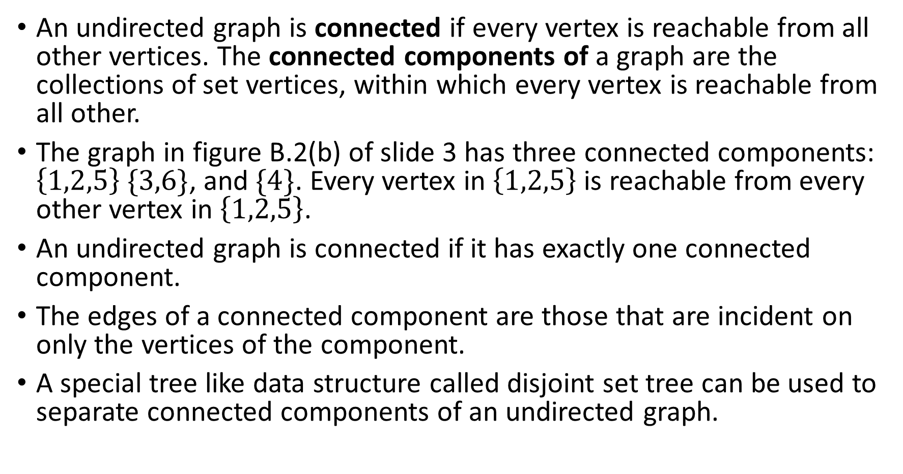
Connected and Strongly Connected Graphs
An undirected graph is connected if every vertex is reachable from all other vertices. The connected components of a graph are the collections of set vertices, within which every vertex is reachable from all other.
The graph in figure B.2(b) of slide 3 has three connected components: $\left\{1,2,5\right\} \{3,6\}$, and $\{4\}$. Every vertex in $\left\{1,2,5\right\}$ is reachable from every other vertex in $\left\{1,2,5\right\}$.
An undirected graph is connected if it has exactly one connected component.
The edges of a connected component are those that are incident on only the vertices of the component.
A special tree like data structure called disjoint set tree can be used to separate connected components of an undirected graph.

Slide 3
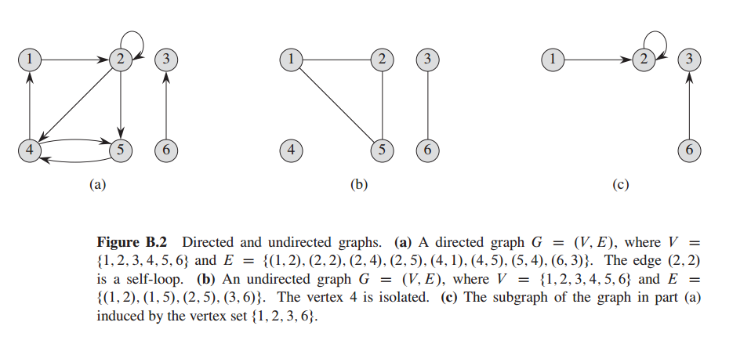

Slide 4
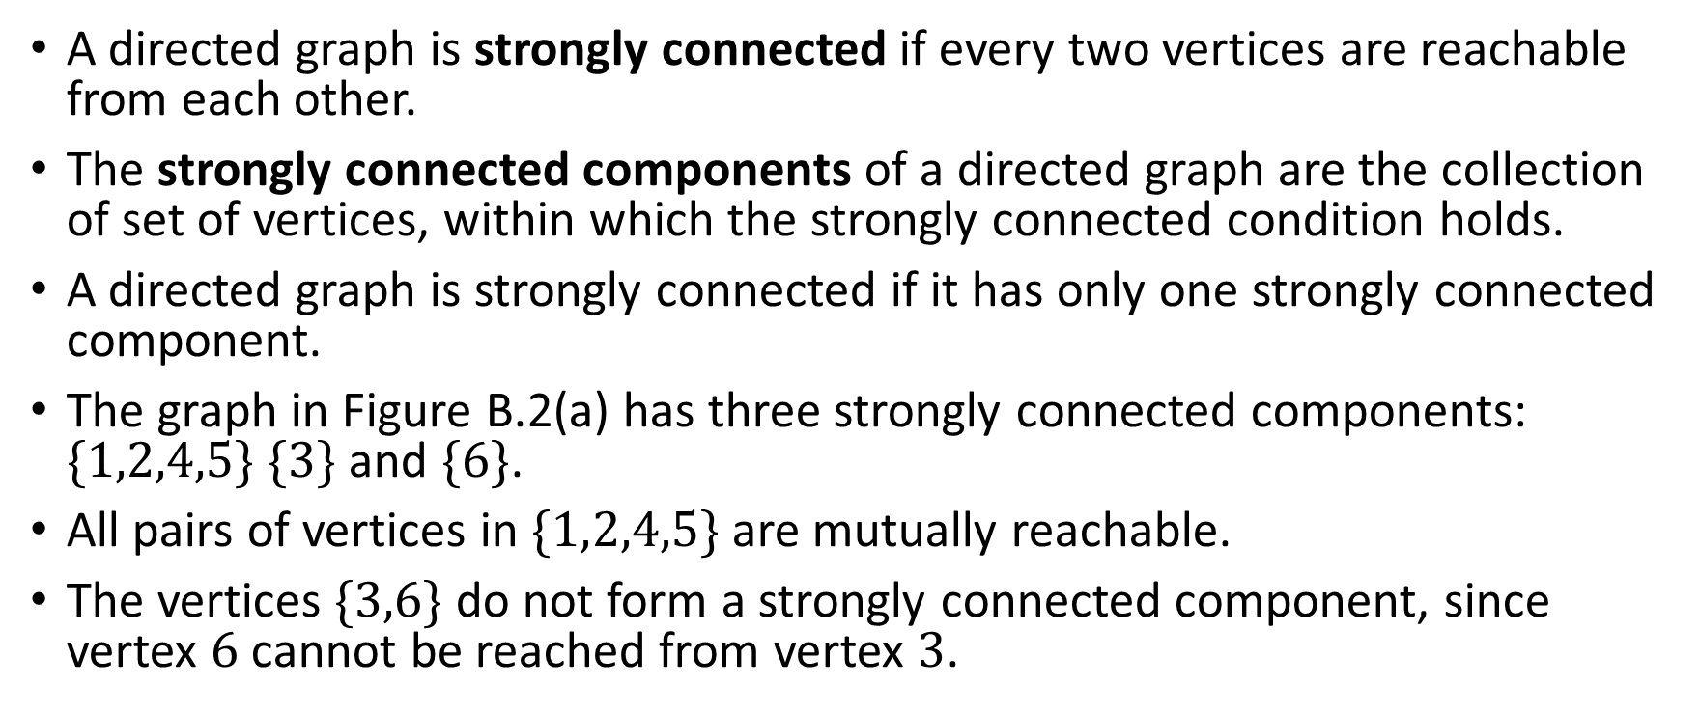
Connected and Strongly Connected Graphs
A directed graph is strongly connected if every two vertices are reachable from each other.
The strongly connected components of a directed graph are the collection of set of vertices, within which the strongly connected condition holds.
A directed graph is strongly connected if it has only one strongly connected component.
The graph in Figure B.2(a) has three strongly connected components: $\{1,2,4,5\}$ $\{3\}$ and $\{6\}$.
All pairs of vertices in $\{1,2,4,5\}$ are mutually reachable.
The vertices $\{3,6\}$ do not form a strongly connected component, since vertex $6$ cannot be reached from vertex $3$.

Slide 5
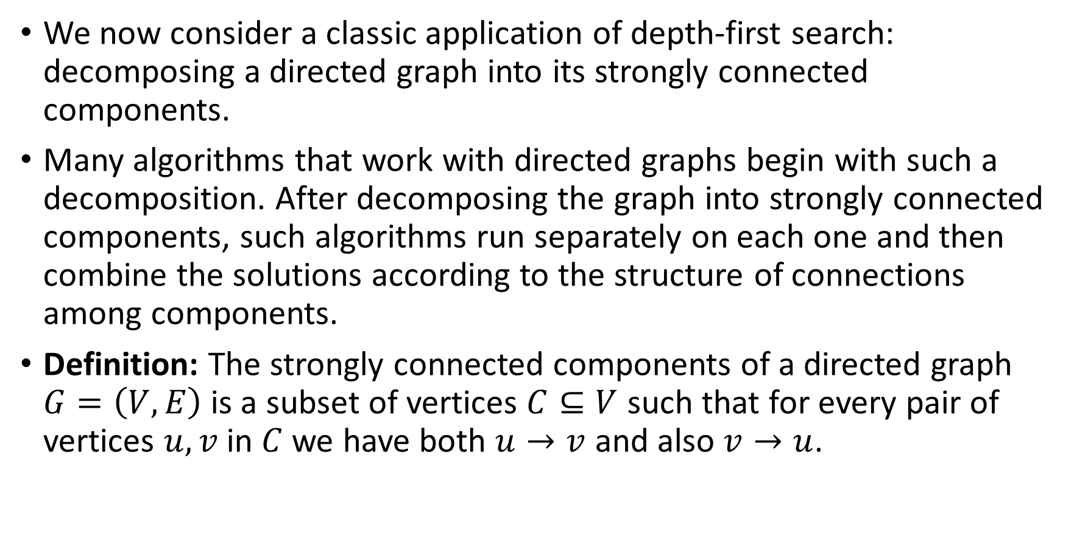
Decomposing a Directed Graph Into Its Strongly Connected Components
We now consider a classic application of depth-first search: decomposing a directed graph into its strongly connected components.
Many algorithms that work with directed graphs begin with such a decomposition. After decomposing the graph into strongly connected components, such algorithms run separately on each one and then combine the solutions according to the structure of connections among components.
Definition: The strongly connected components of a directed graph $G=\left(V,E\right)$is a subset of vertices $C⊆V$ such that for every pair of vertices $u,v$ in $C$ we have both $u→v$ and also $v→u$.

Slide 6
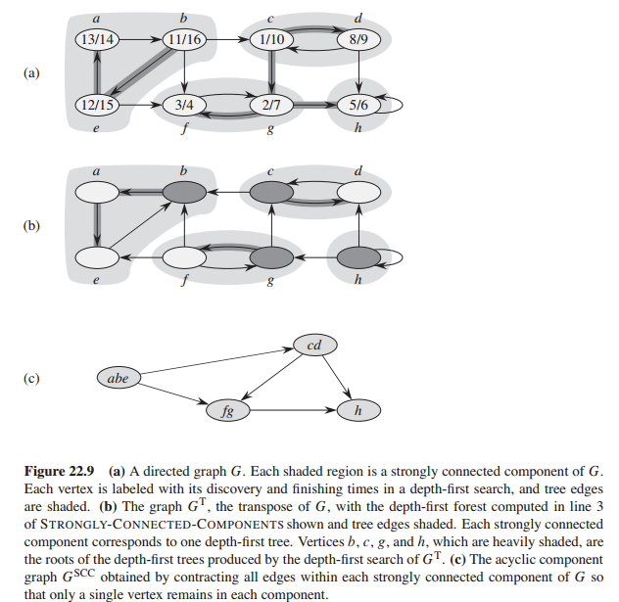

Slide 7
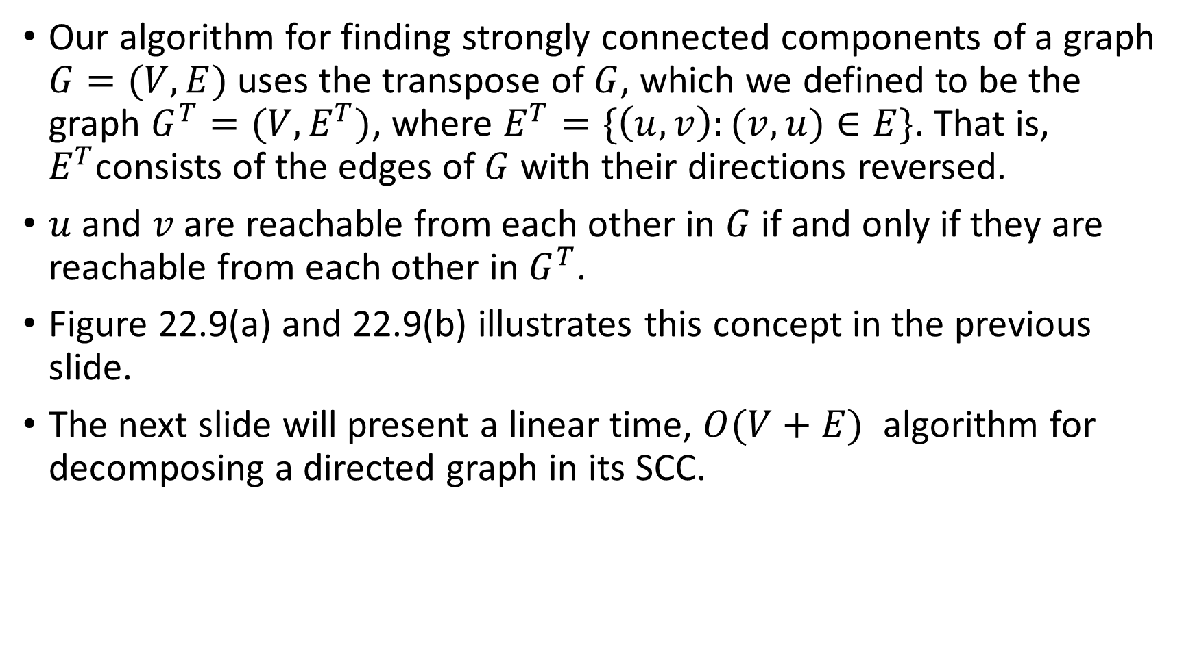
A Very Simple Linear Time Algorithm for Computing SCC
Our algorithm for finding strongly connected components of a graph $G=(V,E)$ uses the transpose of $G$, which we defined to be the graph $G^{T}=(V,E^{T})$, where $E^{T}=\{\left(u,v\right):(v,u)∈E\}$. That is, $E^{T}$consists of the edges of $G$ with their directions reversed.
$u$ and $v$ are reachable from each other in $G$ if and only if they are reachable from each other in $G^{T}$.
Figure 22.9(a) and 22.9(b) illustrates this concept in the previous slide.
The next slide will present a linear time, $O(V+E)$ algorithm for decomposing a directed graph in its SCC.

Slide 8
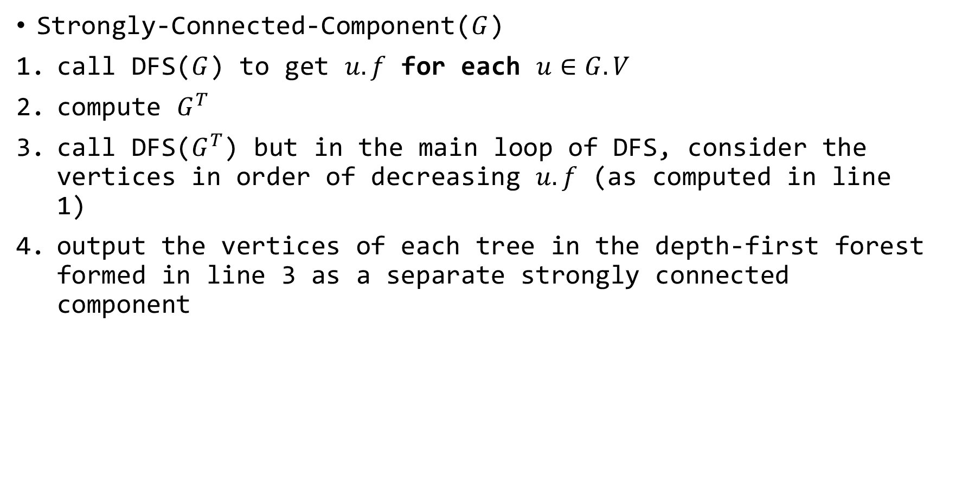
Decomposing a Directed Graph Into SCC
Strongly-Connected-Component($G$)
call DFS($G$) to get $u.f$ for each $u∈G.V$
compute $G^{T}$
call DFS($G^{T}$) but in the main loop of DFS, consider the vertices in order of decreasing $u.f$ (as computed in line 1)
output the vertices of each tree in the depth-first forest formed in line 3 as a separate strongly connected component

Slide 9

The Union-Find Disjoint Set Data Structure
A disjoint set data structure maintains a collection $℘=\{S_{1},..,S_{k}\}$ of disjoint dynamic sets.
We identify each of them by a representative which is a member of the set.
We represent each set element by an object.
Let $x$ denote an object and we wish to support the following operations(next slide)

Slide 10
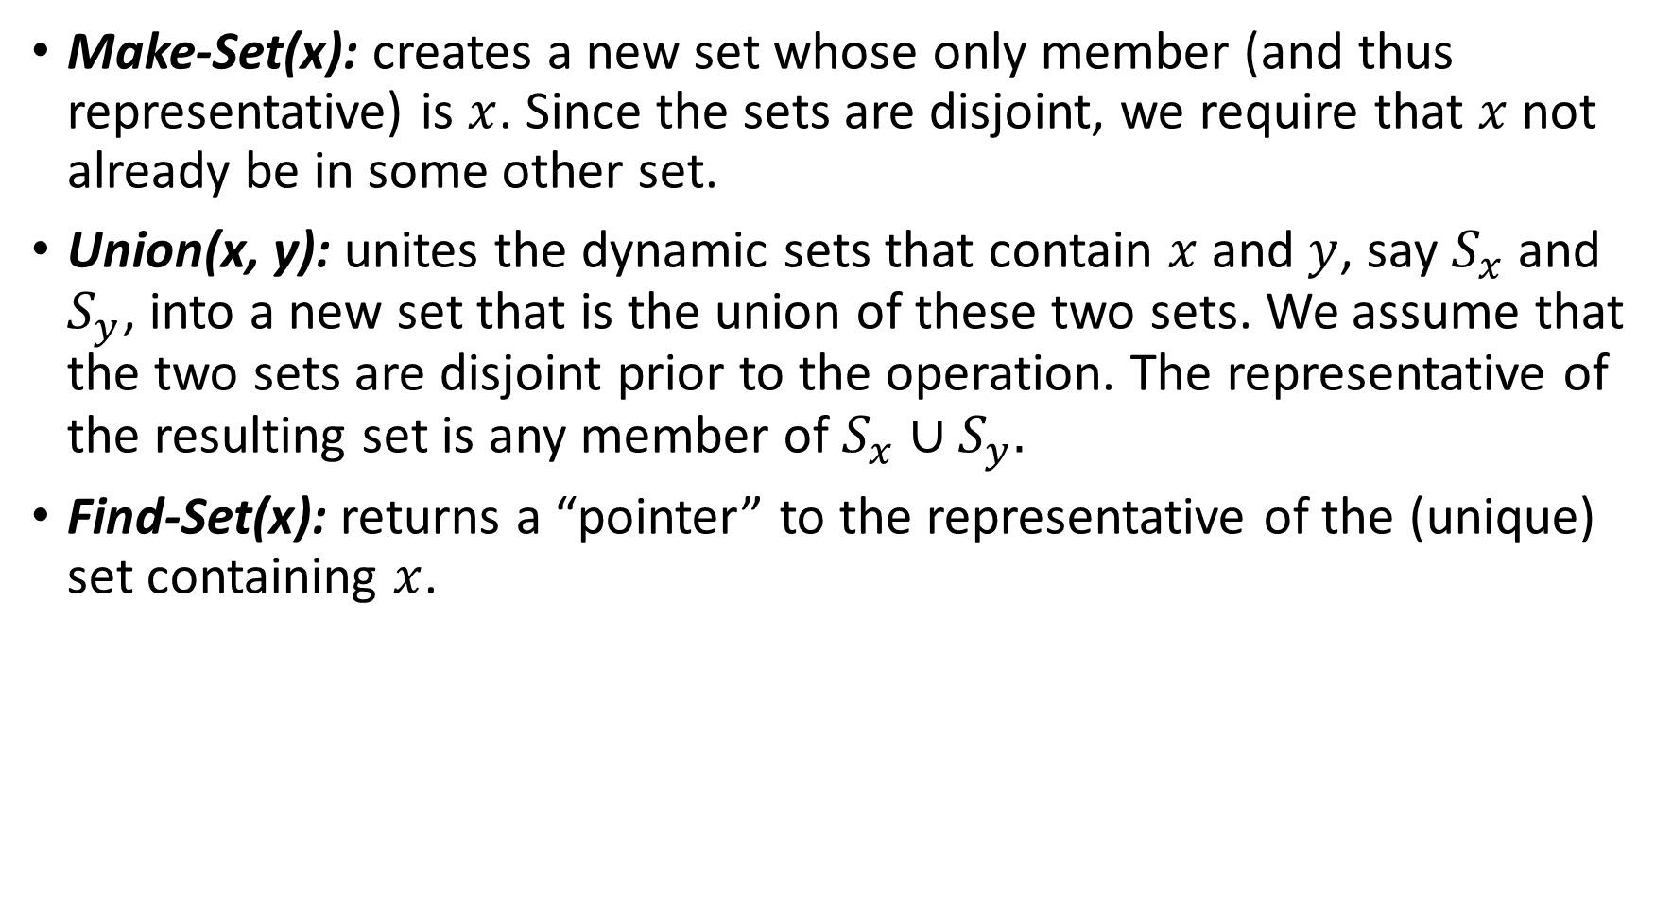
Union-Find Disjoint Set Data Structure Operations
Make-Set(x): creates a new set whose only member (and thus representative) is $x$. Since the sets are disjoint, we require that $x$ not already be in some other set.
Union(x, y): unites the dynamic sets that contain $x$ and $y$, say $S_{x}$ and $S_{y}$, into a new set that is the union of these two sets. We assume that the two sets are disjoint prior to the operation. The representative of the resulting set is any member of $S_{x}∪S_{y}.$
Find-Set(x): returns a “pointer” to the representative of the (unique) set containing $x$.

Slide 11
Decomposing an Undirected Graph in Connected Components
One of the many applications of disjoint-set data structures arises in determining the connected components of an undirected graph.
Figure 21.1(a) of next slide, for example, shows a graph with four connected components.
The procedure Connected-Components that follows uses the disjoint-set operations to compute the connected components of a graph.
Once Connected-Components has preprocessed the graph, the procedure Same-Component answers queries about whether two vertices are in the same connected component.

Slide 12
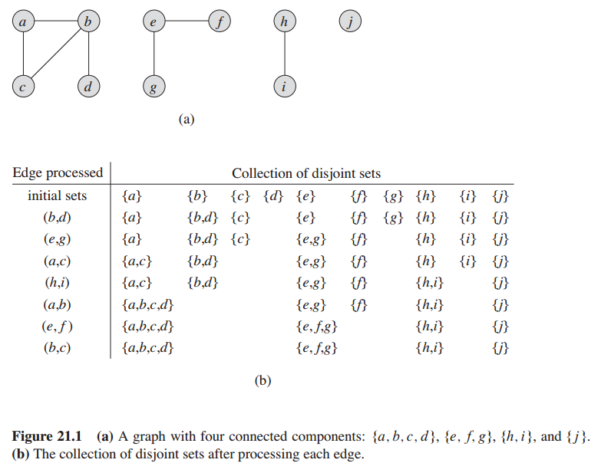

Slide 13
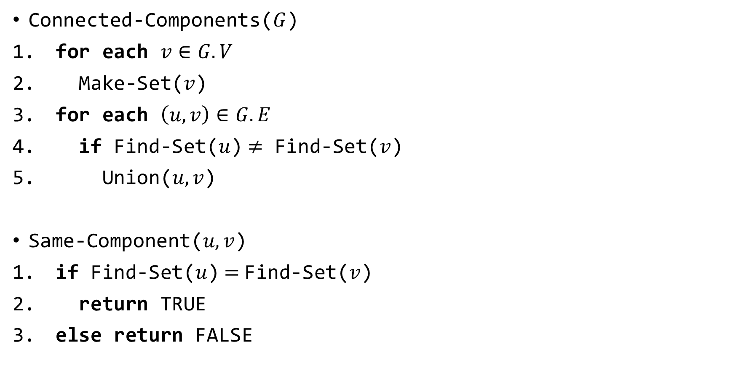
The Algorithms
Connected-Components($G$)
for each $v∈G.V$
Make-Set($v$)
for each $\left(u,v\right)∈G.E$
if Find-Set($u$)$≠$ Find-Set($v$)
Union($u,v$)
Same-Component($u, v$)
if Find-Set($u$)$=$Find-Set($v$)
return TRUE
else return FALSE

Slide 14

Runtime Analysis
Make-Set takes $O(\lg{V)}$time
Find-Set takes $O(\lg{V})$ time.
So the Connected-Components procedure takes $O(E\lg{V})$ time.

Slide 15
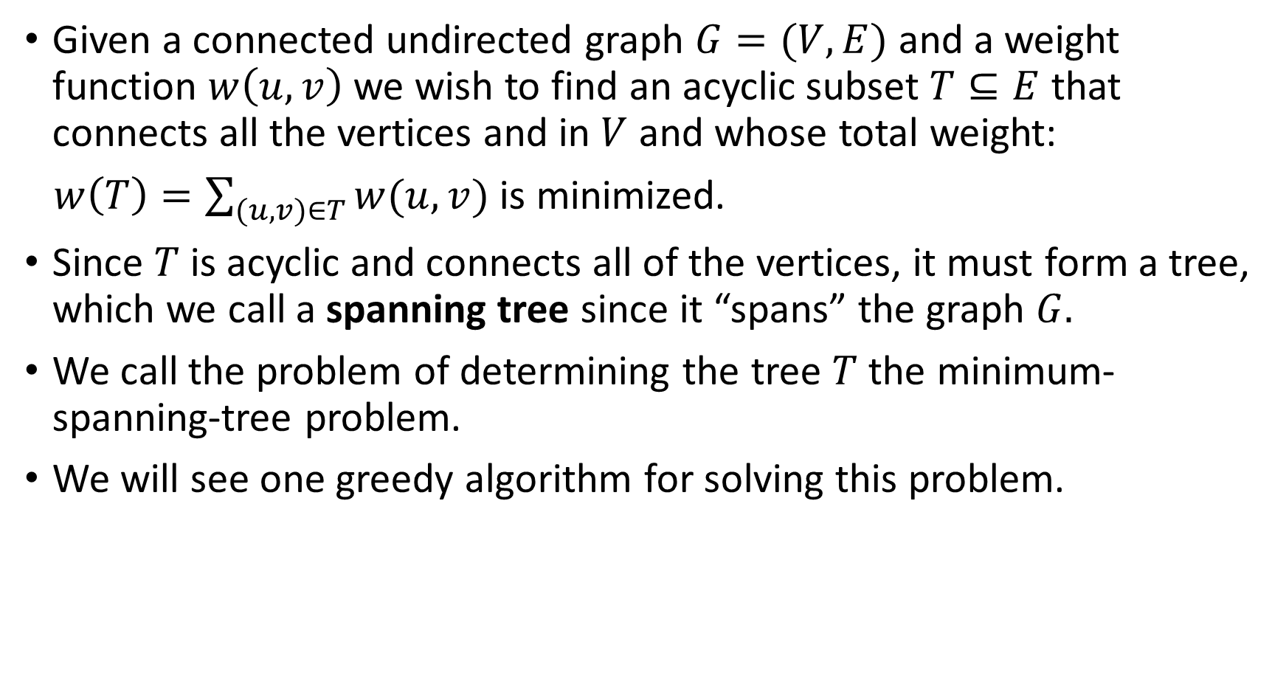
Minimum Spanning Tree
Given a connected undirected graph $G=(V,E)$ and a weight function $w\left(u,v\right)$ we wish to find an acyclic subset $T⊆E$ that connects all the vertices and in $V$ and whose total weight:
$w\left(T\right)=\sum_{(u,v)∈T}{w(u,v)}$ is minimized.
Since $T$is acyclic and connects all of the vertices, it must form a tree, which we call a spanning tree since it “spans” the graph $G.$
We call the problem of determining the tree $T$ the minimum-spanning-tree problem.
We will see one greedy algorithm for solving this problem.

Slide 16
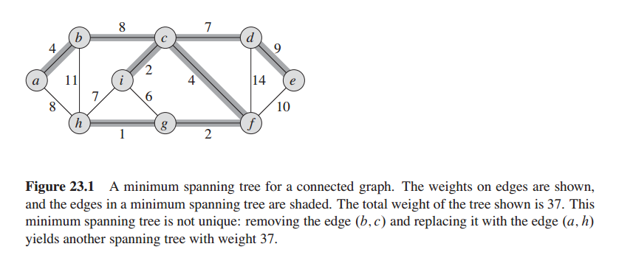

Slide 17
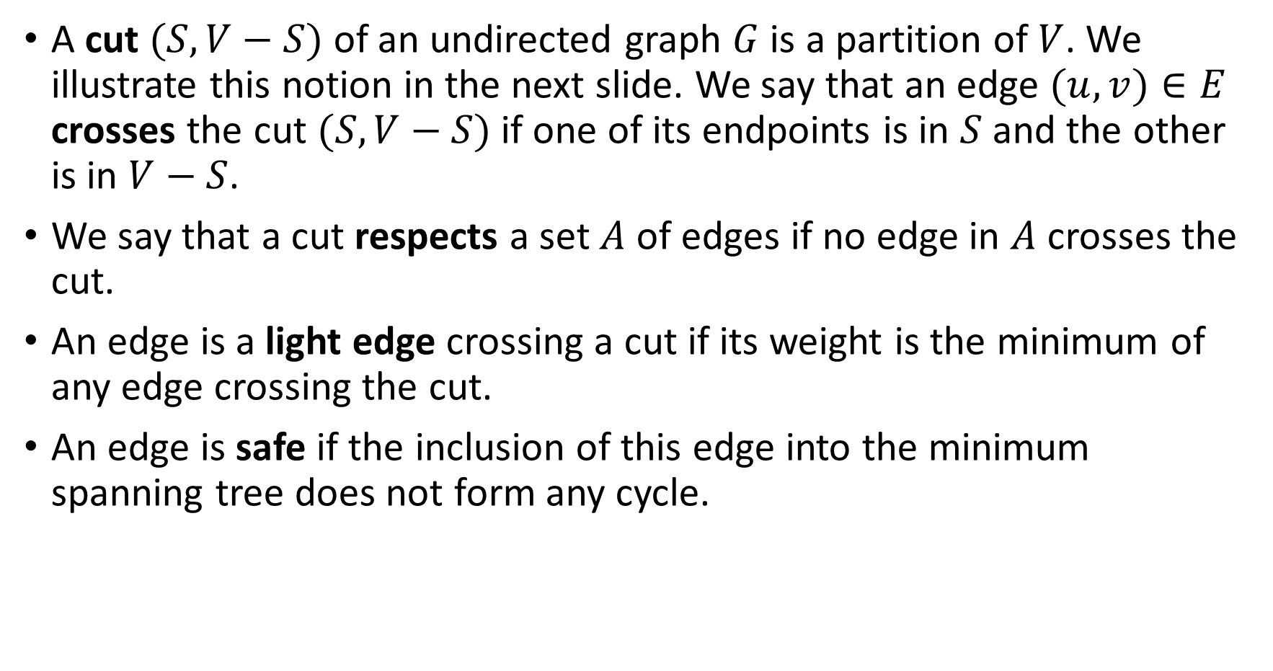
Some Definitions
A cut $(S,V−S)$ of an undirected graph $G$ is a partition of $V$. We illustrate this notion in the next slide. We say that an edge $(u,v)∈E$ crosses the cut $(S, V−S)$ if one of its endpoints is in $S$ and the other is in $V−S$.
We say that a cut respects a set $A$ of edges if no edge in $A$ crosses the cut.
An edge is a light edge crossing a cut if its weight is the minimum of any edge crossing the cut.
An edge is safe if the inclusion of this edge into the minimum spanning tree does not form any cycle.

Slide 18
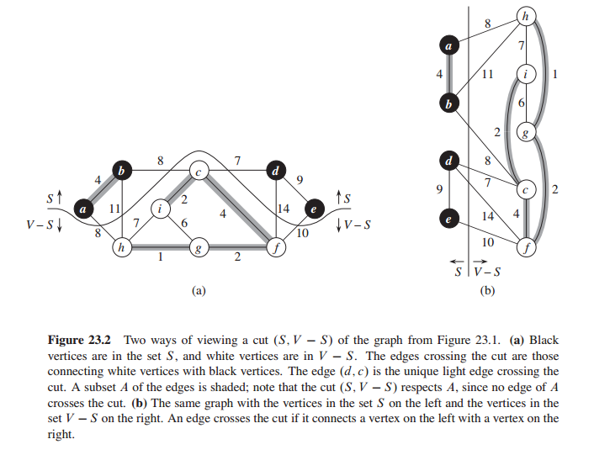

Slide 19
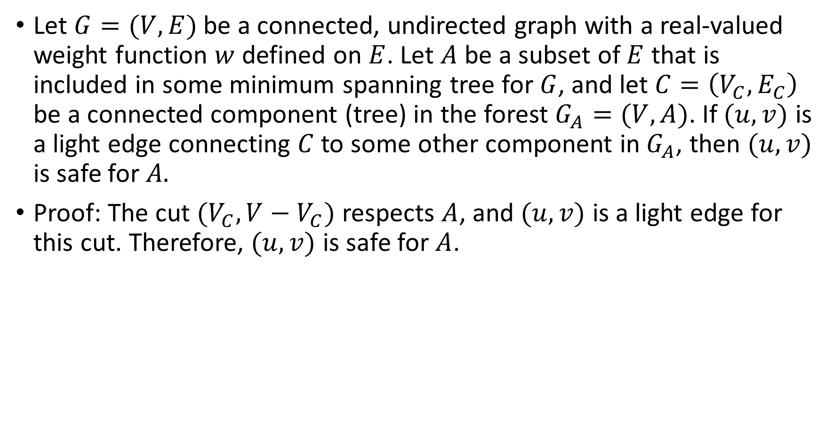
A Corollary
Let $G=(V,E)$ be a connected, undirected graph with a real-valued weight function $w$ defined on $E$. Let $A$ be a subset of $E$ that is included in some minimum spanning tree for $G$, and let $C=\left(V_{C},E_{C}\right)$ be a connected component (tree) in the forest $G_{A}=(V,A)$. If $(u,v)$ is a light edge connecting $C$ to some other component in$G_{A}$, then $(u,v)$ is safe for $A.$
Proof: The cut $(V_{C},V−V_{C})$ respects $A$, and $(u,v)$ is a light edge for this cut. Therefore, $(u,v)$ is safe for $A$.

Slide 20
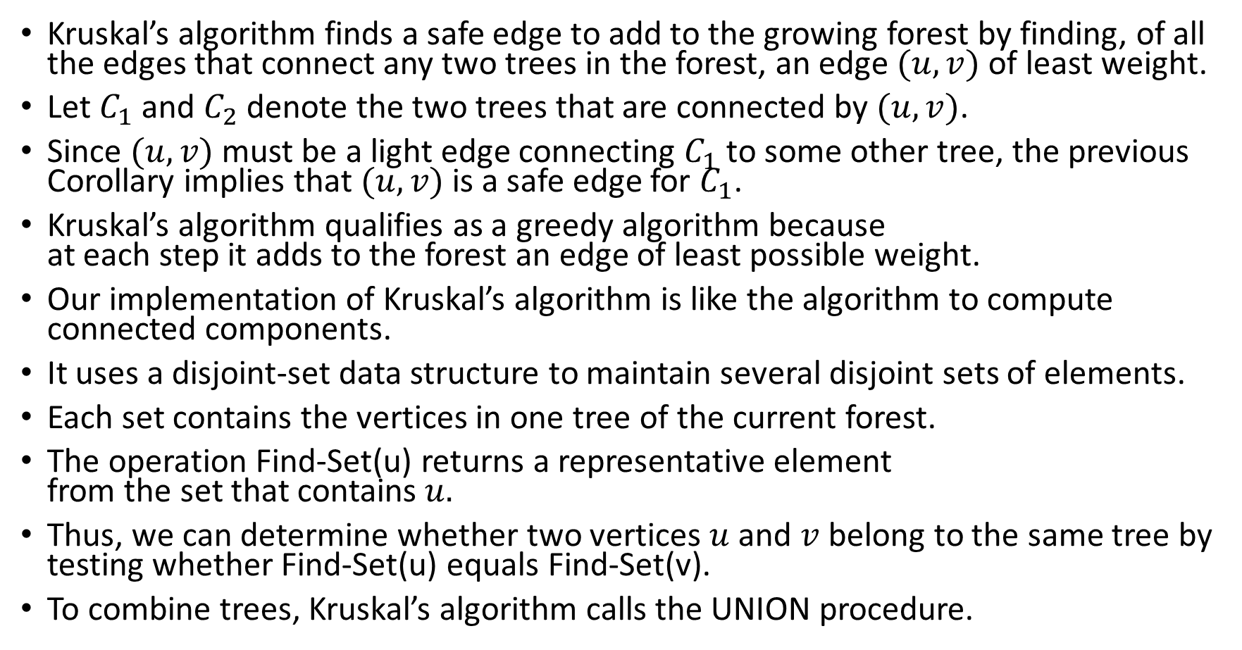
Kruskal’s Algorithm
Kruskal’s algorithm finds a safe edge to add to the growing forest by finding, of all the edges that connect any two trees in the forest, an edge $(u,v)$ of least weight.
Let $C_{1}$ and $C_{2}$ denote the two trees that are connected by $(u,v)$.
Since $(u,v)$ must be a light edge connecting $C_{1}$ to some other tree, the previous Corollary implies that $(u,v)$ is a safe edge for $C_{1}$.
Kruskal’s algorithm qualifies as a greedy algorithm because at each step it adds to the forest an edge of least possible weight.
Our implementation of Kruskal’s algorithm is like the algorithm to compute connected components.
It uses a disjoint-set data structure to maintain several disjoint sets of elements.
Each set contains the vertices in one tree of the current forest.
The operation Find-Set(u) returns a representative element from the set that contains $u.$
Thus, we can determine whether two vertices $u$ and $v$ belong to the same tree by testing whether Find-Set(u) equals Find-Set(v).
To combine trees, Kruskal’s algorithm calls the UNION procedure.

Slide 21
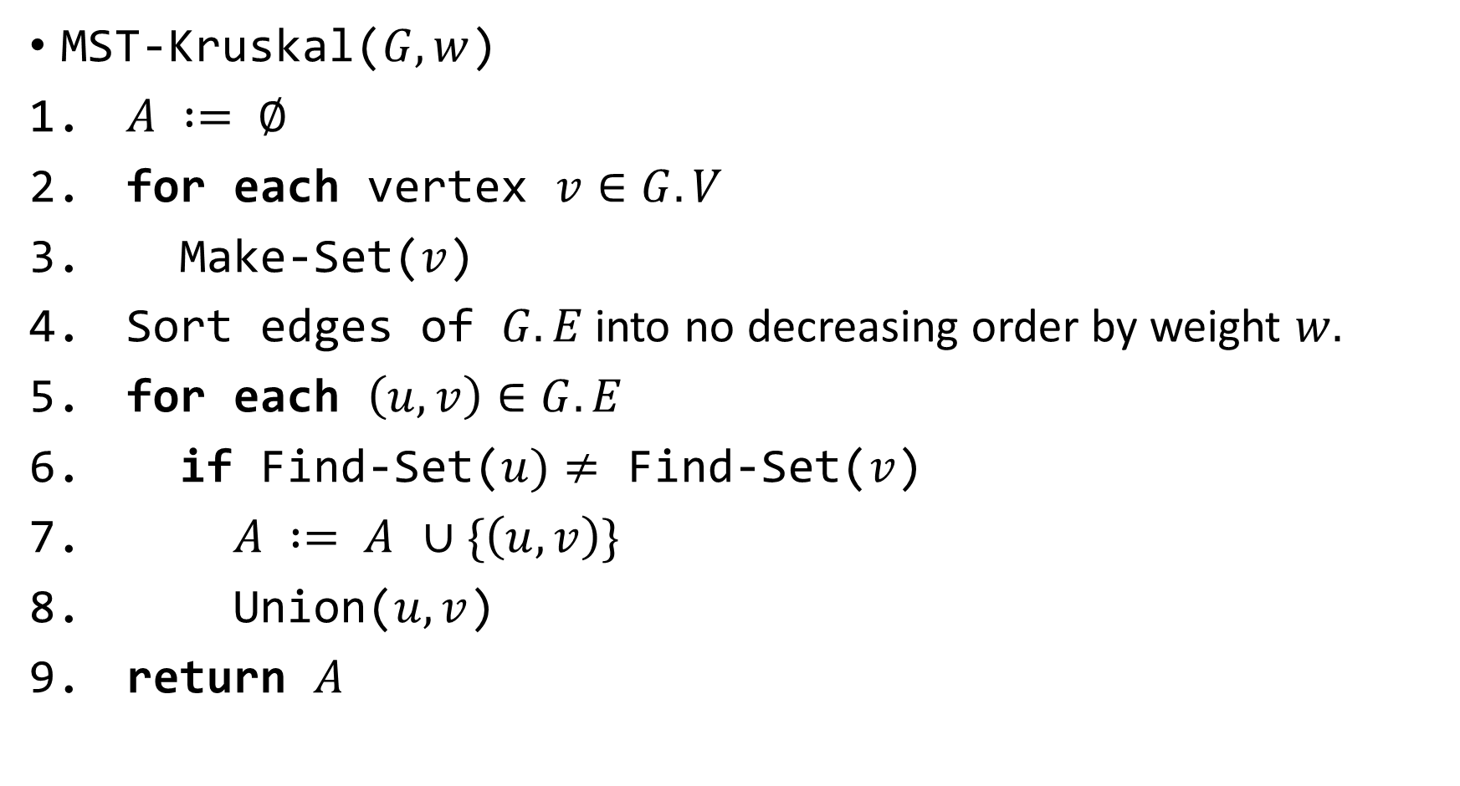
The Algorithm
MST-Kruskal($G, w$)
$A := ∅$
for each vertex $v∈G.V$
Make-Set($v$)
Sort edges of $G.E$into no decreasing order by weight $w.$
for each $\left(u,v\right)∈G.E$
if Find-Set($u)≠$ Find-Set($v$)
$A := A$ $∪\{\left(u,v\right)\}$
Union($u,v$)
return $A$

Slide 22
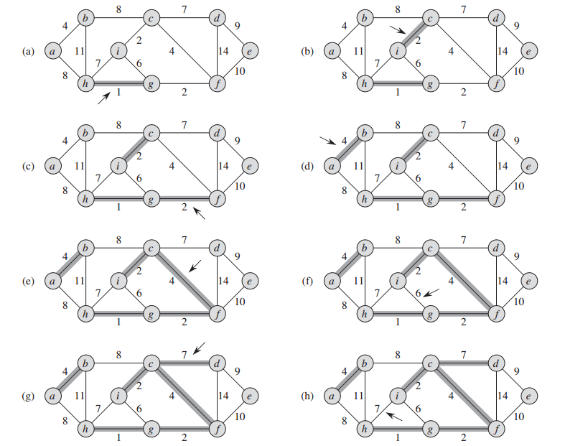

Slide 23
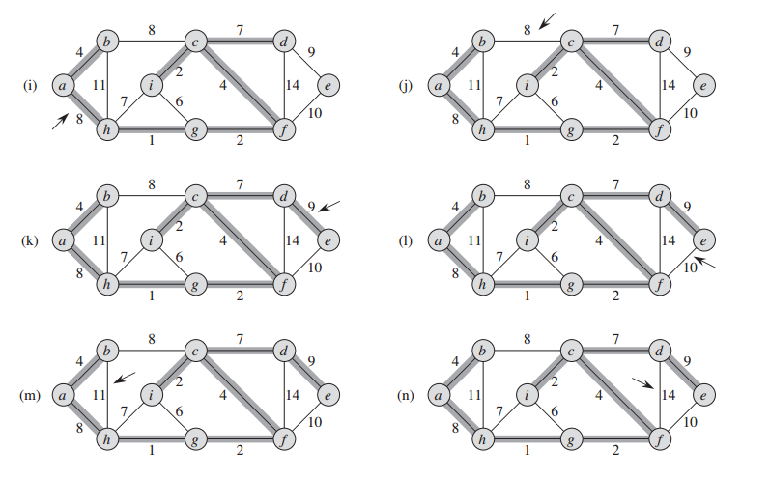

Slide 24
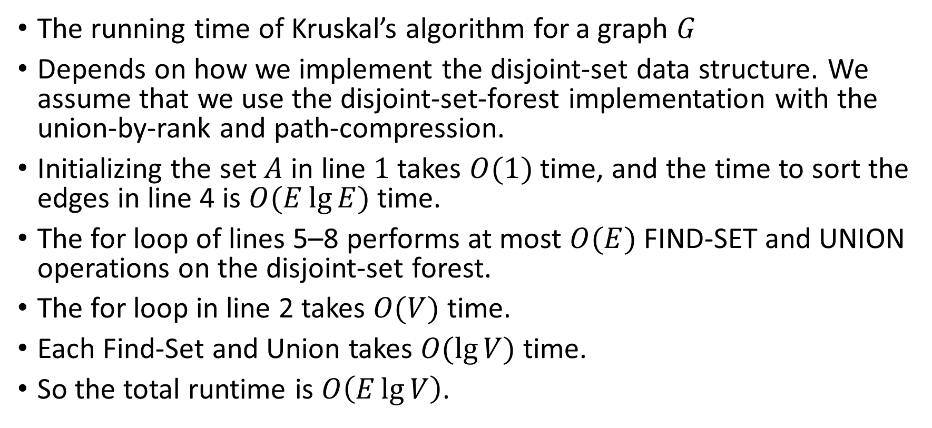
The Runtime of Kruskal’s Algorithm
The running time of Kruskal’s algorithm for a graph $G$
Depends on how we implement the disjoint-set data structure. We assume that we use the disjoint-set-forest implementation with the union-by-rank and path-compression.
Initializing the set $A$ in line $1$ takes $O(1)$ time, and the time to sort the edges in line 4 is $O(E\lg{E})$ time.
The for loop of lines 5–8 performs at most $O(E)$ FIND-SET and UNION operations on the disjoint-set forest.
The for loop in line 2 takes $O(V)$ time.
Each Find-Set and Union takes $O(\lg{V})$ time.
So the total runtime is $O\left(E\lg{V}\right)$.

Slide 25
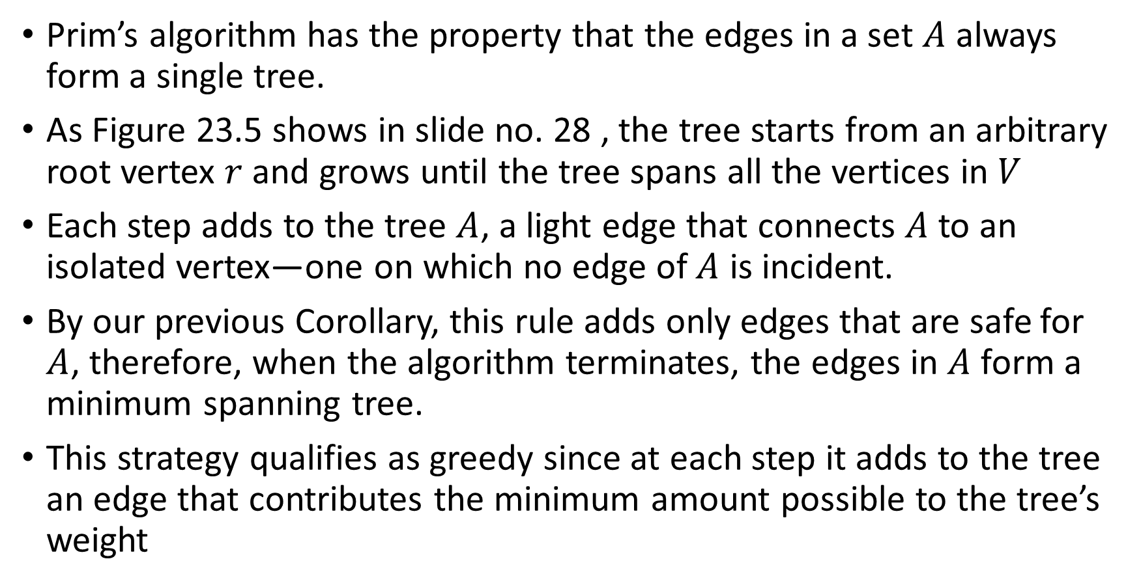
Prim’s Algorithm
Prim’s algorithm has the property that the edges in a set $A$ always form a single tree.
As Figure 23.5 shows in slide no. 28 , the tree starts from an arbitrary root vertex $r$ and grows until the tree spans all the vertices in $V$
Each step adds to the tree $A$, a light edge that connects $A$ to an isolated vertex—one on which no edge of $A$ is incident.
By our previous Corollary, this rule adds only edges that are safe for $A$, therefore, when the algorithm terminates, the edges in $A$ form a minimum spanning tree.
This strategy qualifies as greedy since at each step it adds to the tree an edge that contributes the minimum amount possible to the tree’s weight

Slide 26
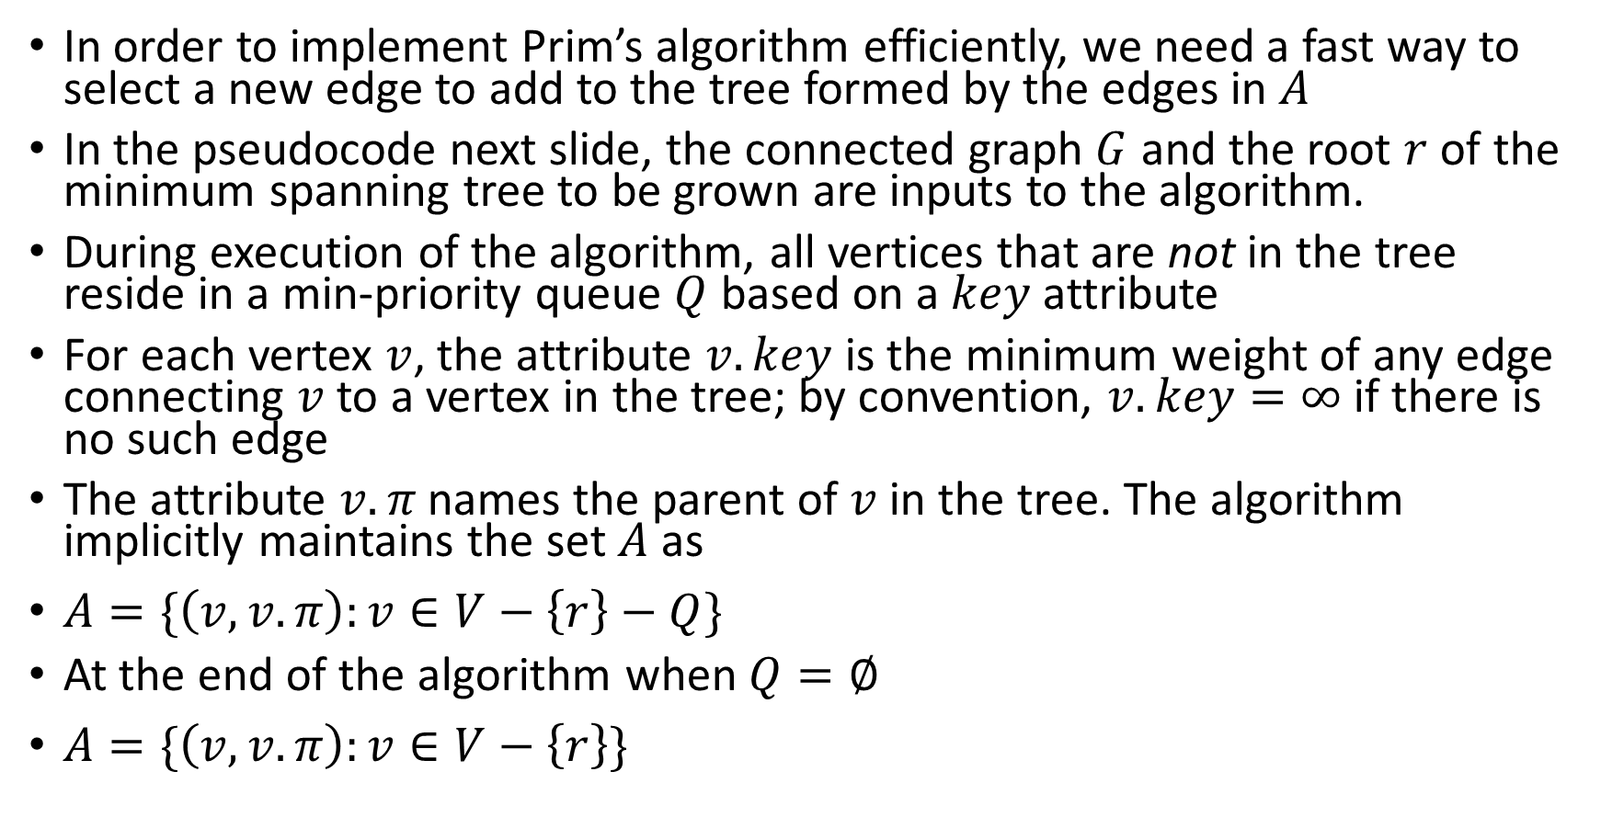
Outline of The Algorithm
In order to implement Prim’s algorithm efficiently, we need a fast way to select a new edge to add to the tree formed by the edges in $A$
In the pseudocode next slide, the connected graph $G$ and the root $r$ of the minimum spanning tree to be grown are inputs to the algorithm.
During execution of the algorithm, all vertices that are not in the tree reside in a min-priority queue $Q$ based on a $key$ attribute
For each vertex $v$, the attribute $v.key$ is the minimum weight of any edge connecting $v$to a vertex in the tree; by convention, $v.key=∞$ if there is no such edge
The attribute $v.π$ names the parent of $v$ in the tree. The algorithm implicitly maintains the set $A$ as
$A=\{\left(v,v.π\right):v∈V−\left\{r\right\}−Q\}$
At the end of the algorithm when $Q=∅$
$A=\{\left(v,v.π\right):v∈V−\left\{r\right\}\}$

Slide 27
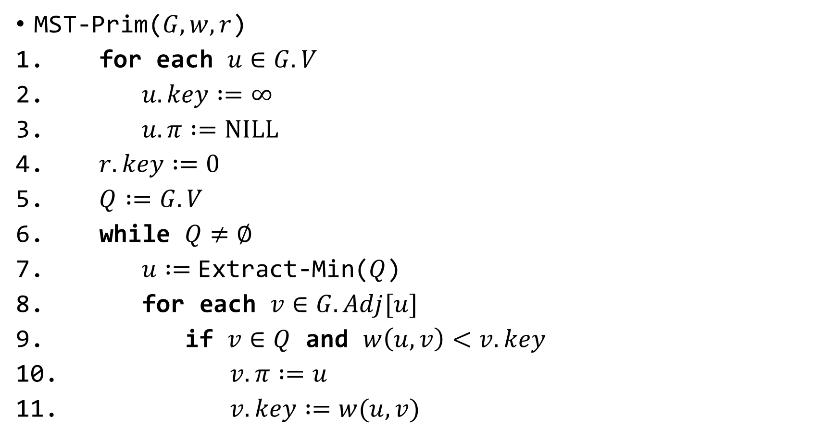
The Algorithm
MST-Prim($G,w,r$)
for each $u∈G.V$
$u.key :=∞$
$u.π :=NILL$
$r.key :=0$
$Q :=G.V$
while $Q≠∅$
$u :=$Extract-Min($Q$)
for each $v∈G.Adj[u]$
if $v∈Q$ and $w\left(u,v\right)<v.key$
$v.π :=u$
$v.key :=w(u,v)$

Slide 28
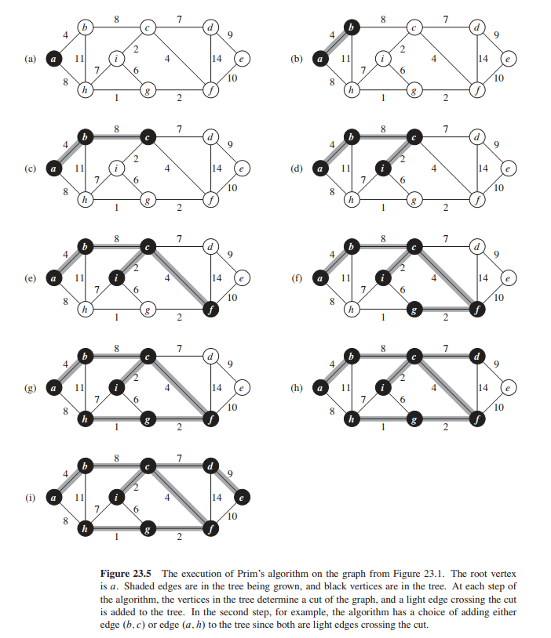

Slide 29
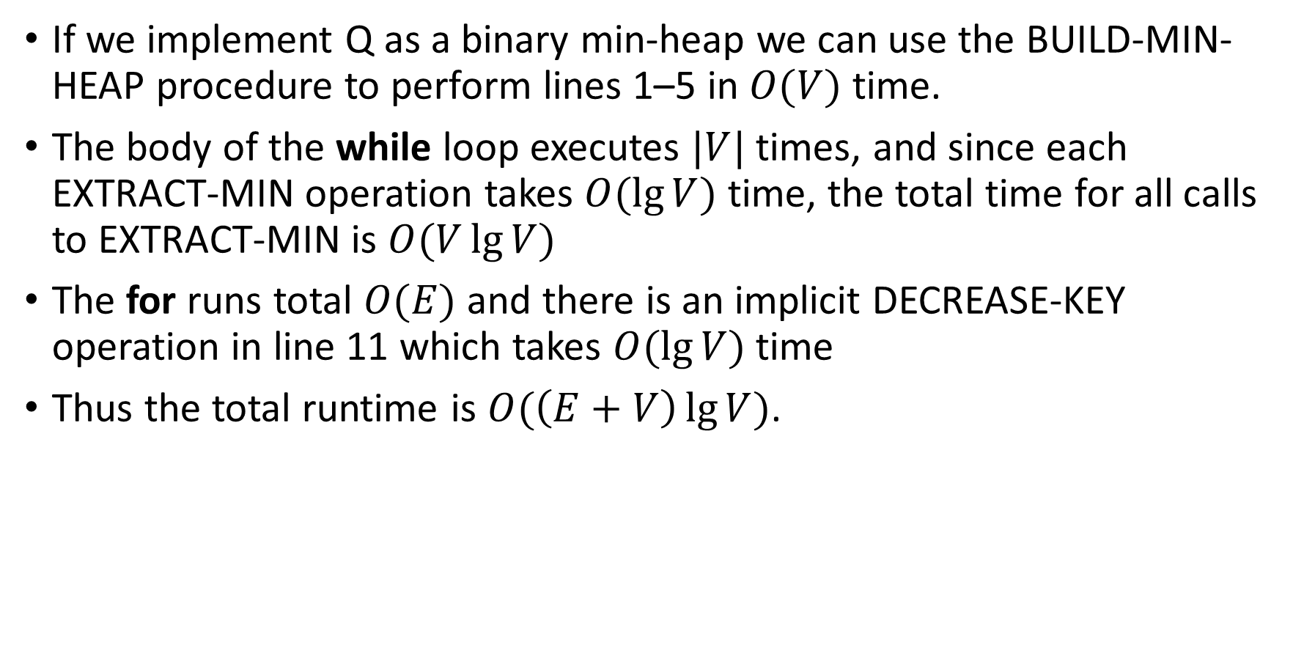
Runtime Analysis
If we implement Q as a binary min-heap we can use the BUILD-MIN-HEAP procedure to perform lines 1–5 in $O(V)$ time.
The body of the while loop executes $|V|$ times, and since each EXTRACT-MIN operation takes $O(\lg{V)}$ time, the total time for all calls to EXTRACT-MIN is $O(V\lg{V})$
The for runs total $O(E)$ and there is an implicit DECREASE-KEY operation in line 11 which takes $O(\lg{V})$ time
Thus the total runtime is $O(\left(E+V\right)\lg{V})$.

